Slide 1

ME 402
2
0
2
1
PREDICTING THE BULLWHIP EFFECT IN A 4 STAGE SUPPLY CHAIN USING MACHINE LEARNING
Submitted by-
2K17 / ME / 008 | ABHINAV DIKSHIT
2K17 / ME / 009 | ABHIRUP PODDAR
2K17 / ME / 059 | ARHAM ANWAR
UNDER PROF. GIRISH KUMAR

Slide 2

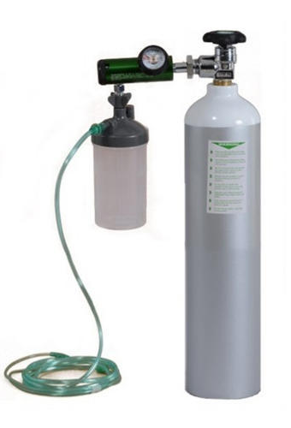
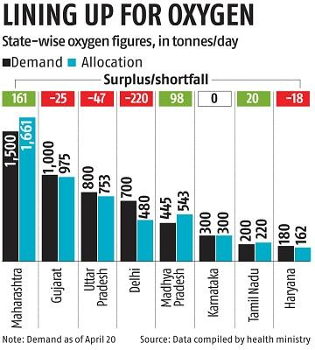
INTRODUCTION
No market is stable
Sudden variations in demand and supply can have a ripple effects
If not predicted at the right time, it can lead to tragic supply chain insufficiencies
This project aims at minimising bullwhip effect with machine learning
Factors : Wars or other conflicts, inflation or deflation, Government fiscal and monetary policy, Technological changes, Natural disasters/extreme weather fluctuations, Corporate or government performance data

Slide 3
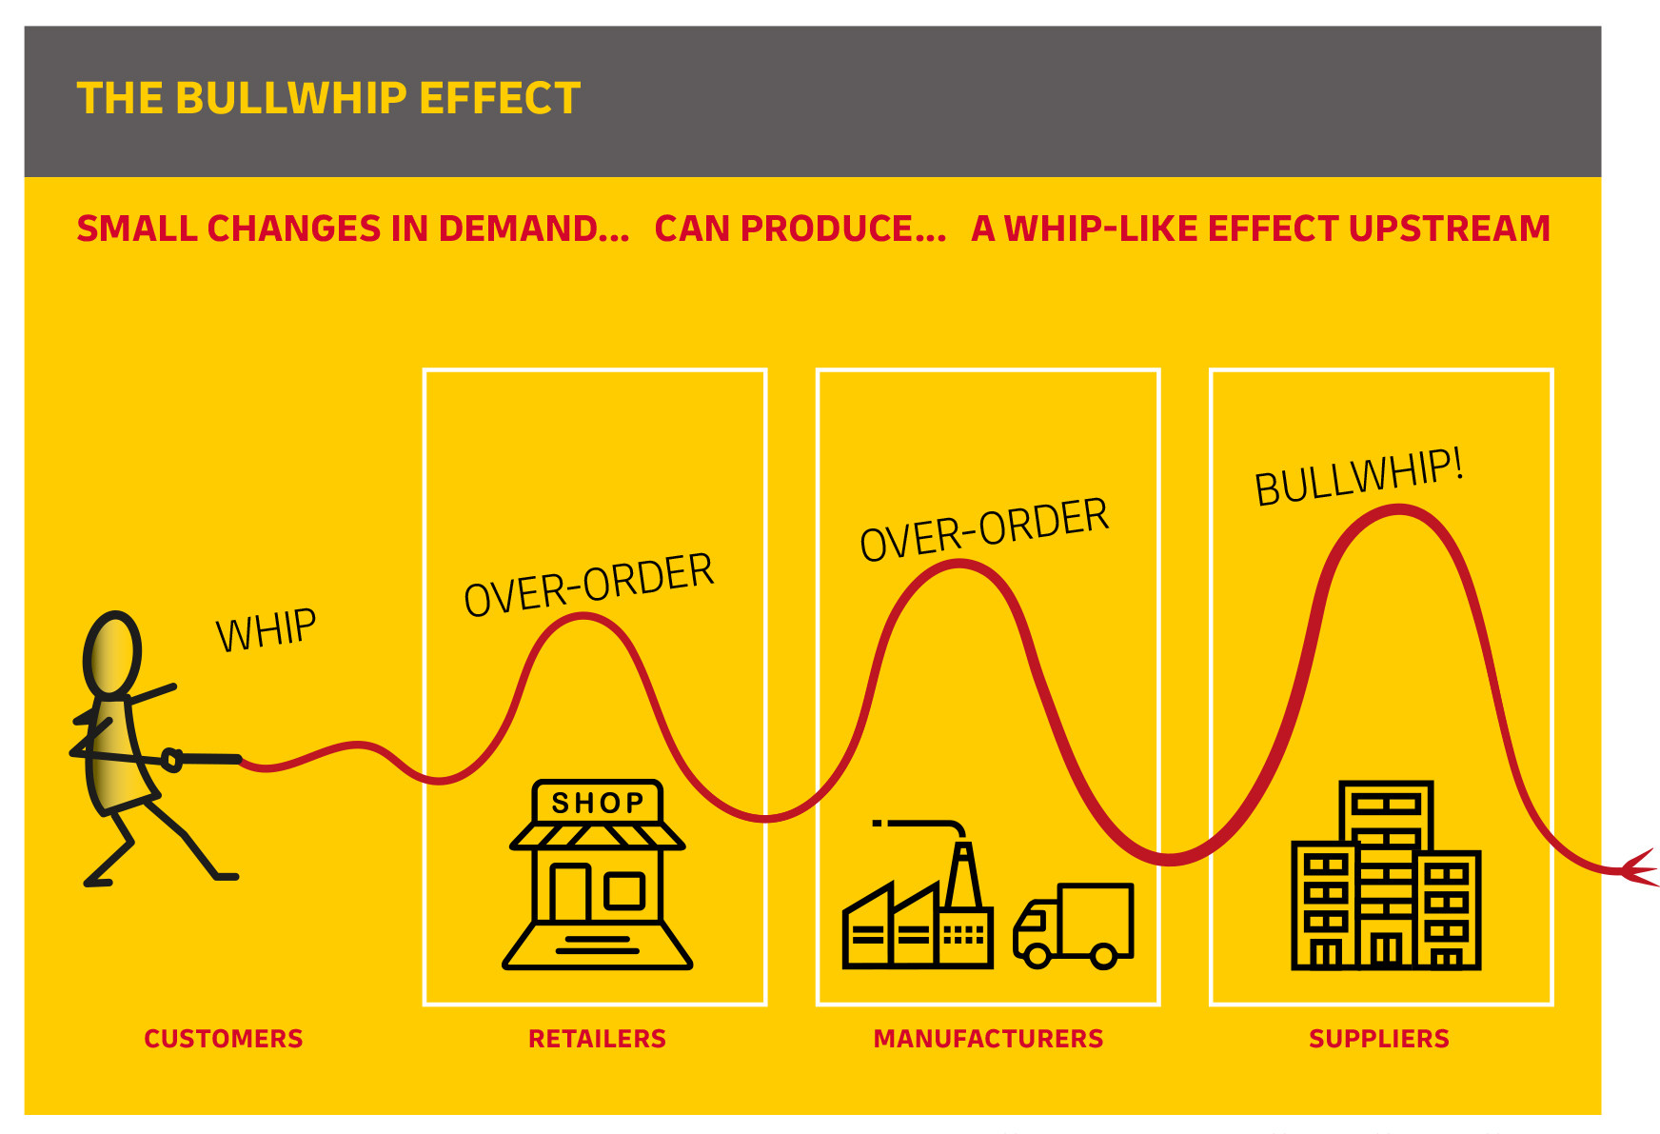
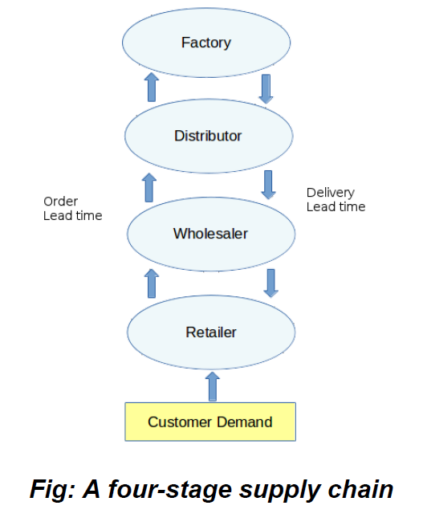
Bullwhip Effect
“Widening of the gap between supply chain demand and supply as we go up the line”
Key deliverables
4-Stage supply chain is simulated using the ‘beer game’ in python to emulate Bullwhip effect
Machine learning is used to optimally reduce the effects of this phenomenon

Slide 4
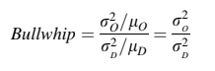
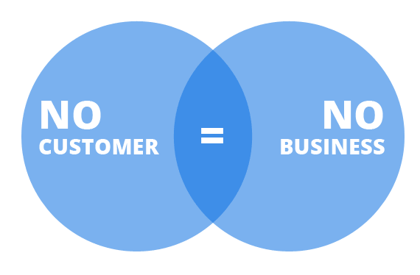


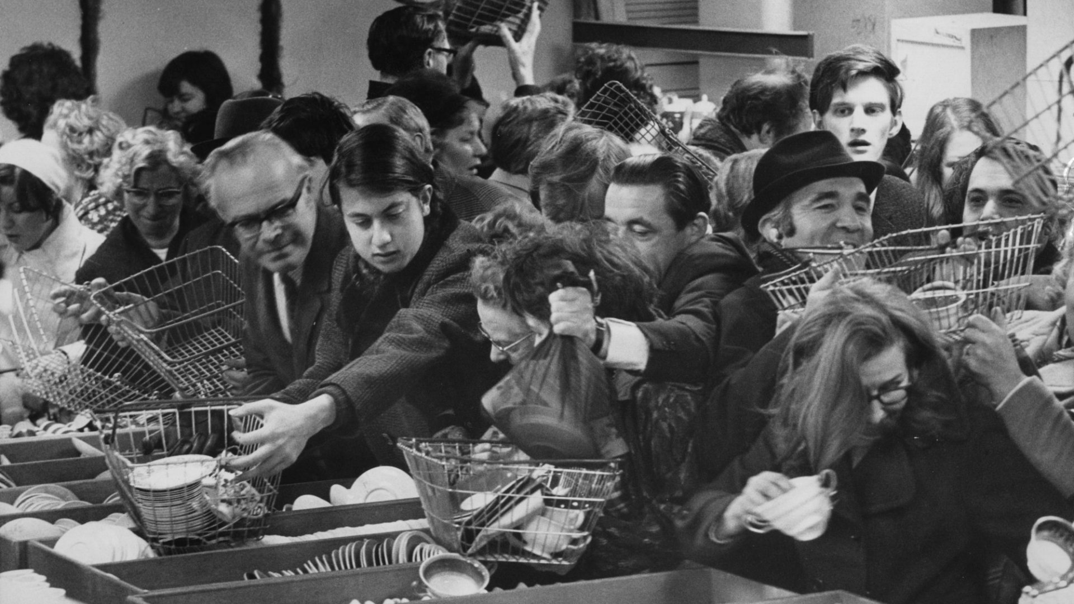
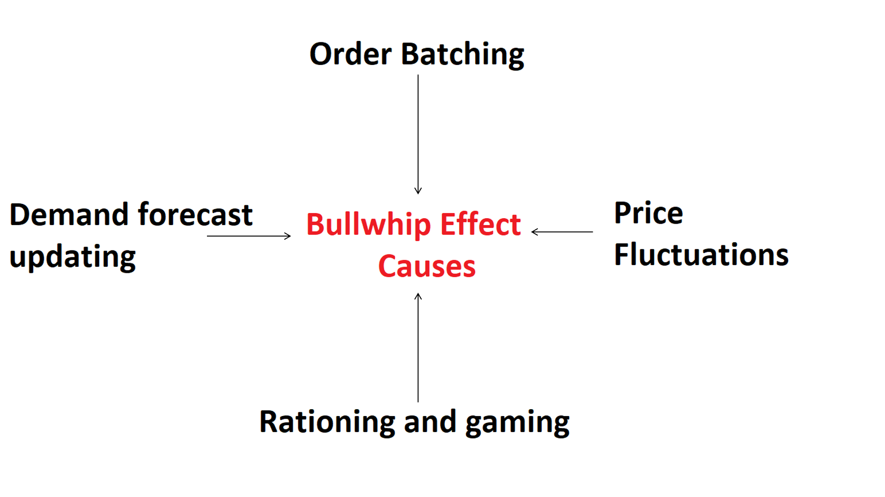
Measuring the bullwhip effect
< 1
“ Isolation effect “
> 1
“ Variance Amplification “

Slide 5
FEATURES AFFECTING BULLWHIP EFFECT
based on extensive literature review*
Demand
Receive
Forecast
Net Stock
Lead Time Delivery
Safety Stock
Order Up to Level (OUT)
Order
Cost

Slide 6
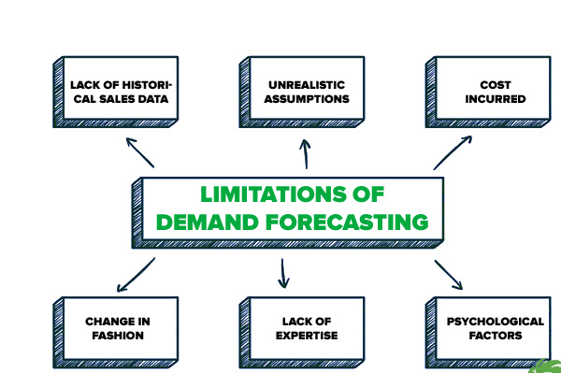
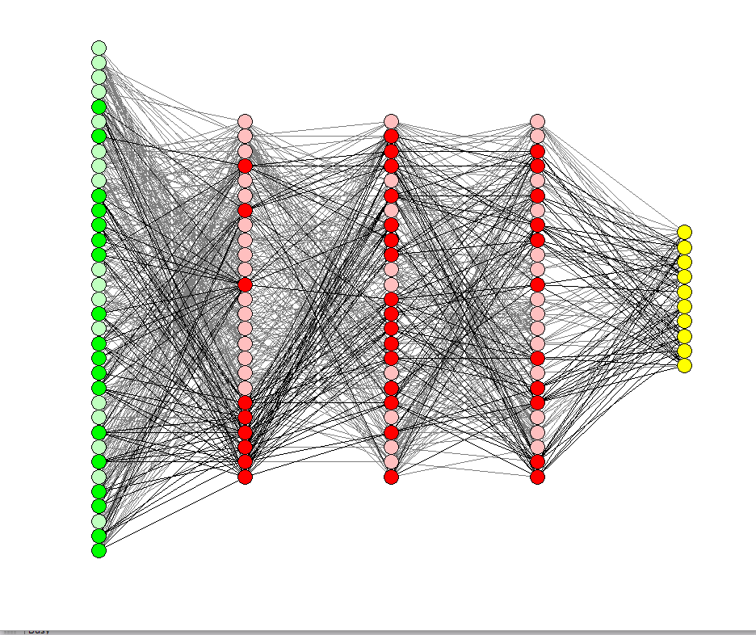
Conventional methods
1. Rationing game ( Forecasting based)
- Naïve method
- Moving average method
- Weighted moving average method
2. Information Sharing
Proposed method
Machine Learning based
Predicts Bullwhip Effect with Demand , Lead time,
Net stock, Order, Order Up to Level
Receive, Safety stock (SS)
MIT BEER GAME is used for data

Slide 7
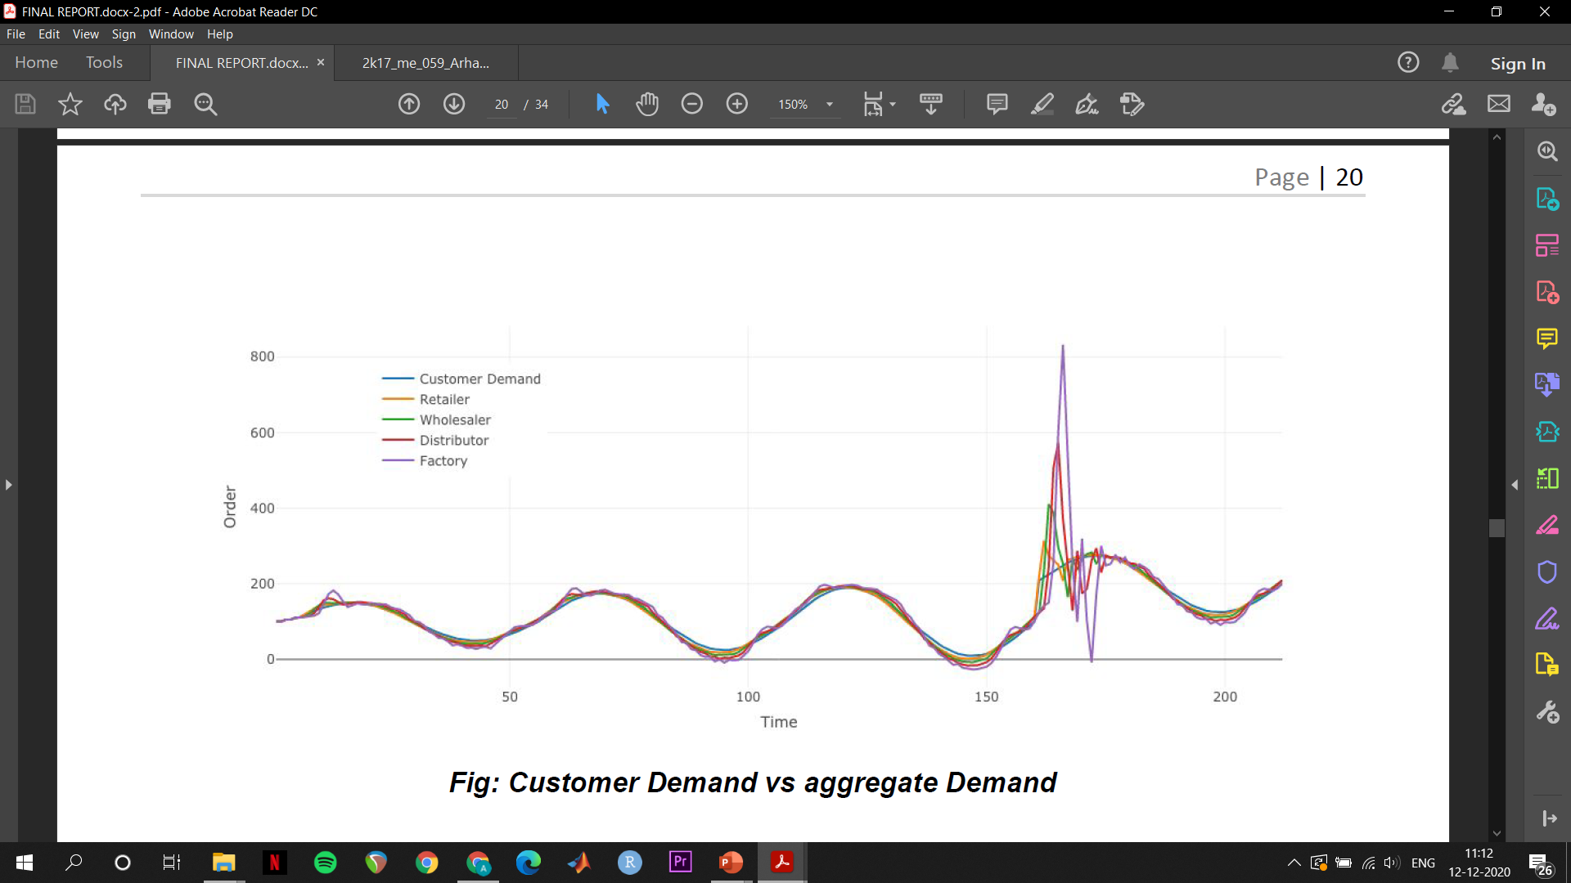
Methodology
Simulation of 4-Stage Supply chain
Data Creation
Data Collection
Data Exploration
Data Cleaning
Data Processing
Data Scaling
ML Modelling
Listing flaws of the model

Slide 8
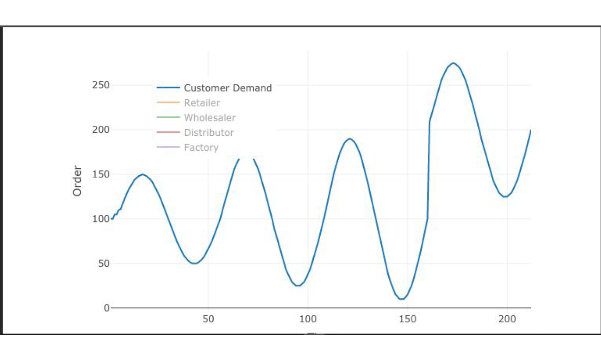
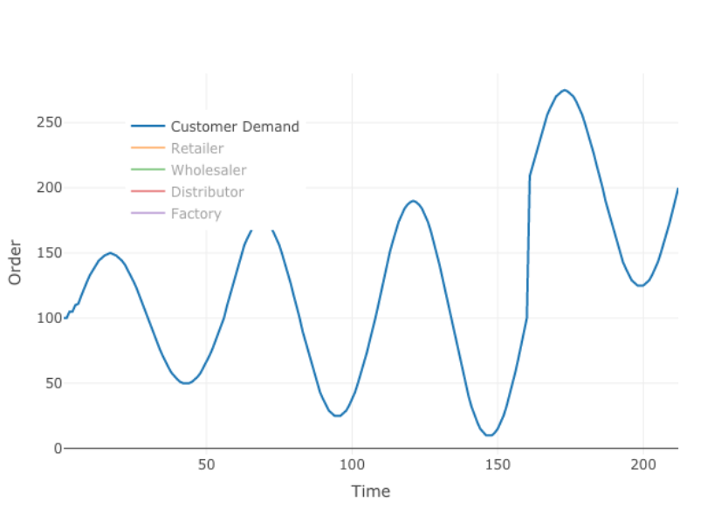
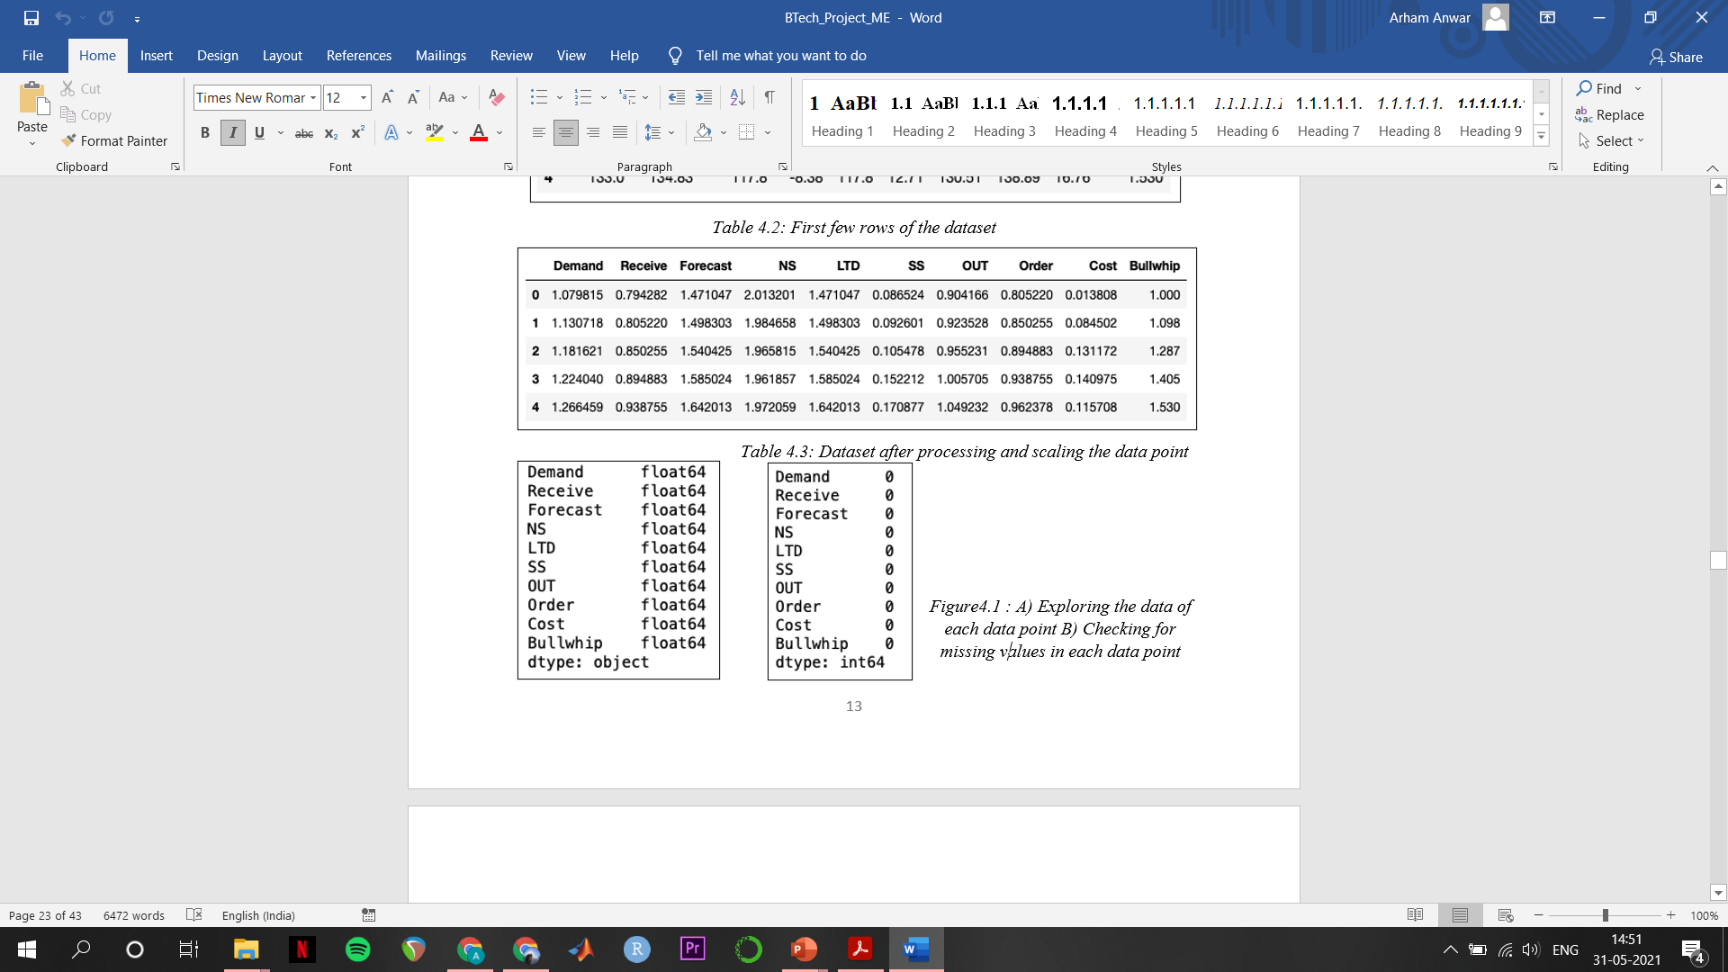

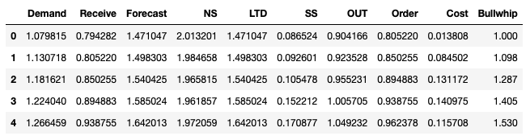
Dataset
Creating Dataset
Data Exploration
Data Cleaning
Data Processing
MIT
Bullwhip Game

Slide 9
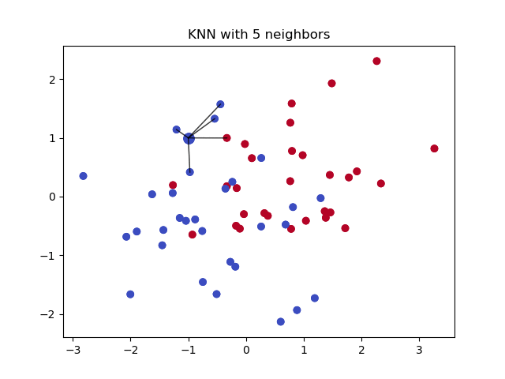
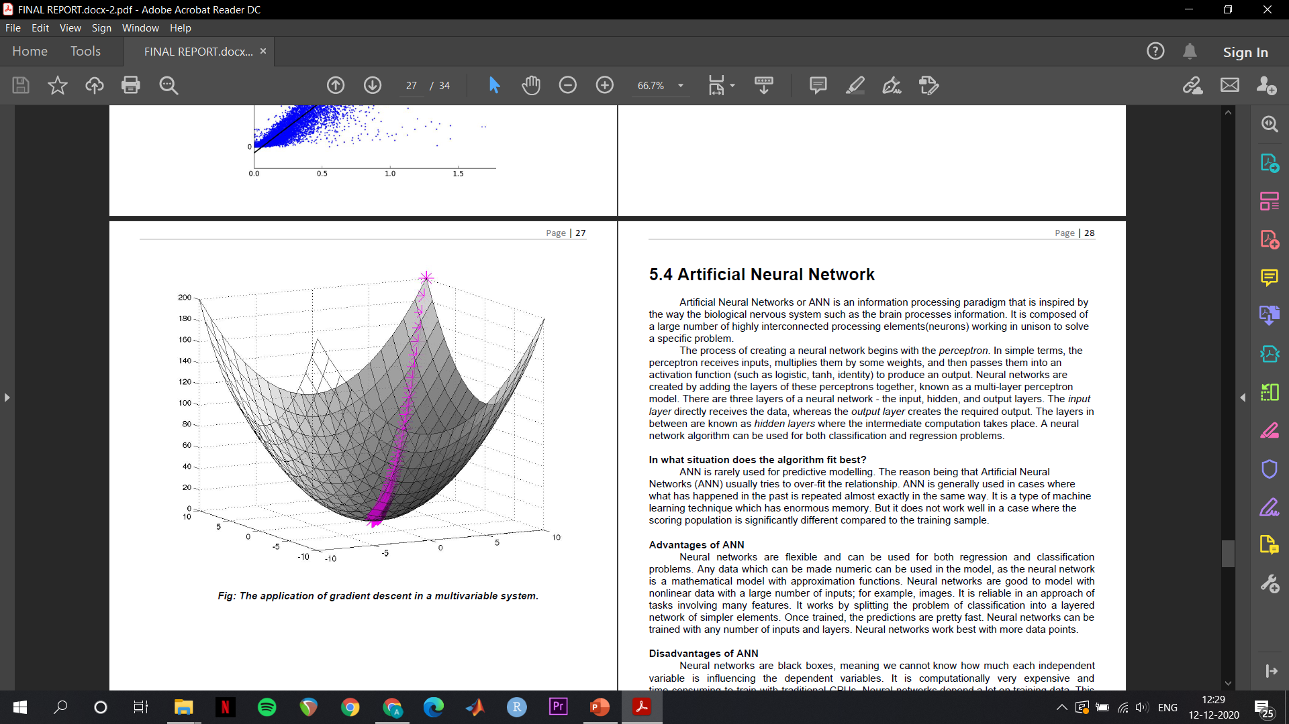
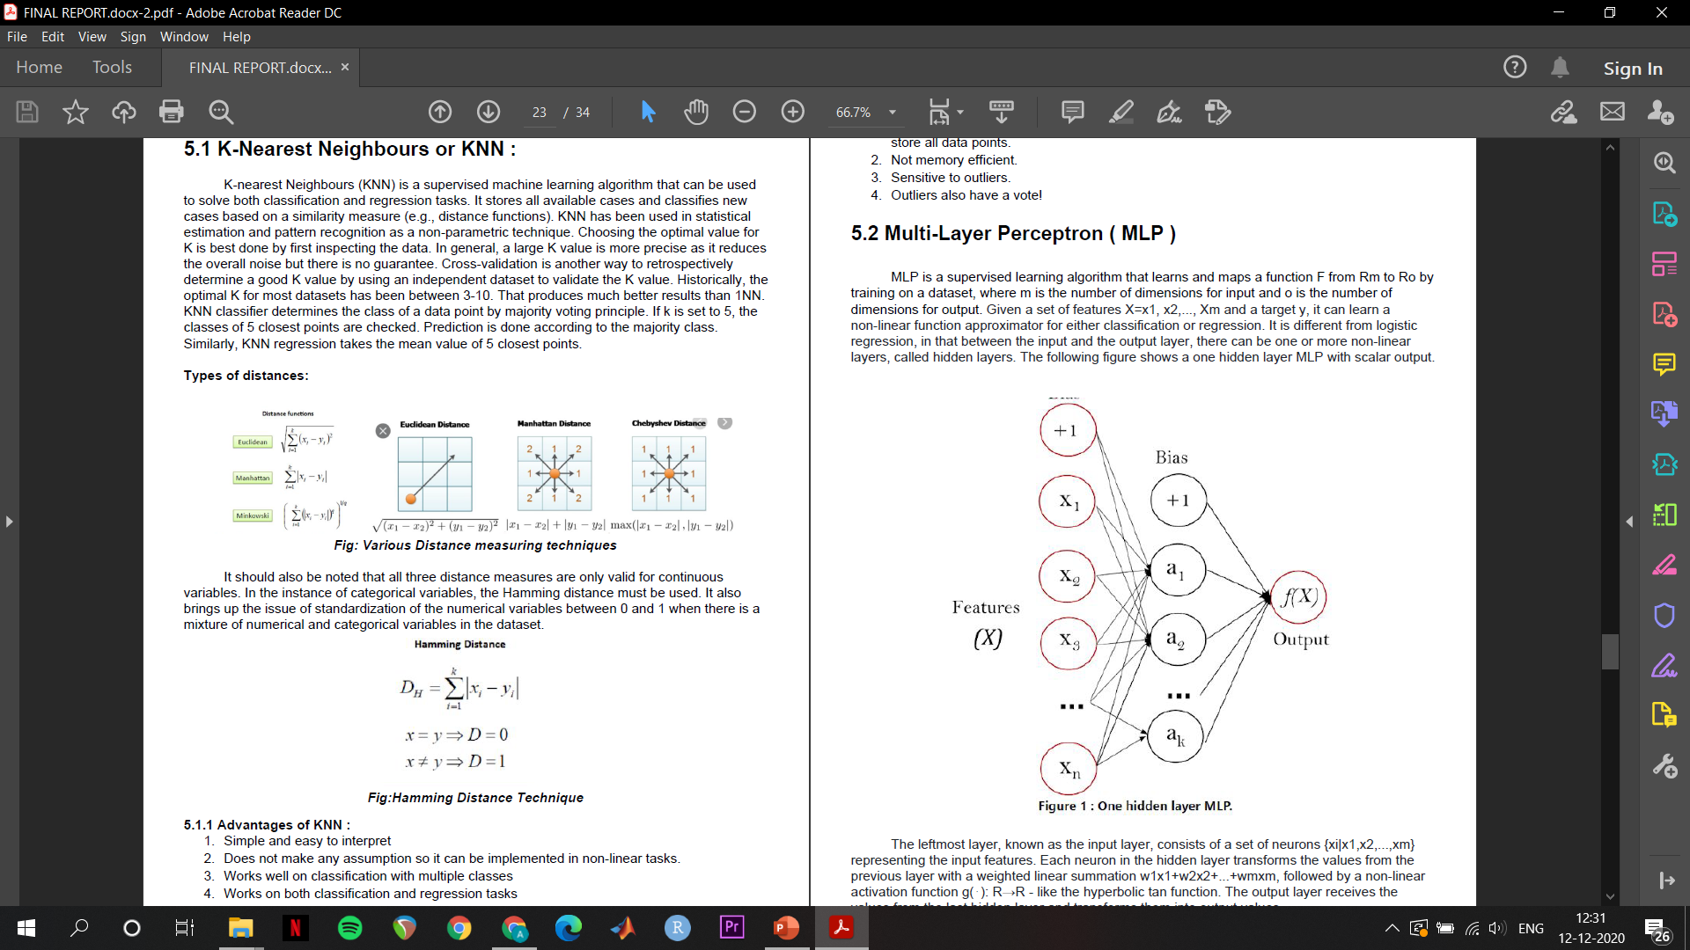
ML Algorithms used
K- Nearest neighbours
2. Decision Tree Regressor
3. MLP

Slide 10
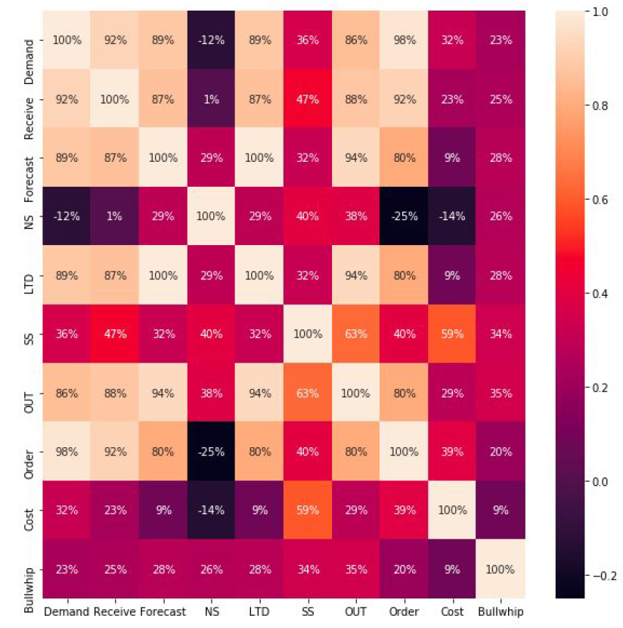
Research Results
Constructed correlation matrix between the various inputs and bullwhip was found to be multi-correlational
With KNN machine found the most accurate result at K=5 which resulted in a prediction score of 54.64%. The prediction was further enhanced by increasing the resolution of the numerical value of bullwhip.
MLP Regressor accuracy was only 23.12% which is explained by the small resolution of bullwhip value in the data

Slide 11

C O N C L U S I O N / F I N D I N G S
Coordination and collaboration -- a plausible remedy to the demand amplification problem, albeit idealistic
In absence of integration among partners the increase in accuracy of demand information will help to reduce the bullwhip effect
.
Research results show promise in AI bullwhip use case, Future research could be directed towards genetic algorithm, fuzzy logic etc in Bullwhip

Slide 12
